Slide 1


Gilang Islamay
18 February 2024

Slide 2

Outline
Executive Summary
Introduction
Methodology
Results
Conclusion
Appendix

Slide 3
Executive Summary
Summary of methodologies
Summary of all results

Slide 4
Introduction
Project background and context
Problems you want to find answers

Slide 5

Section 1

Slide 6
Methodology
Executive Summary
Data collection methodology:
Through API and Web Scarping!
Perform data wrangling
One Hot Encoding!
Perform exploratory data analysis (EDA) using visualization and SQL
Perform interactive visual analytics using Folium and Plotly Dash
Perform predictive analysis using classification models
Build, tune, and evaluate classification models!

Slide 7
Data Collection
Datasets were collected using two methods, which are
SpaceX Api
SpaceX Web Scraping using BeautifulSoup

Slide 8
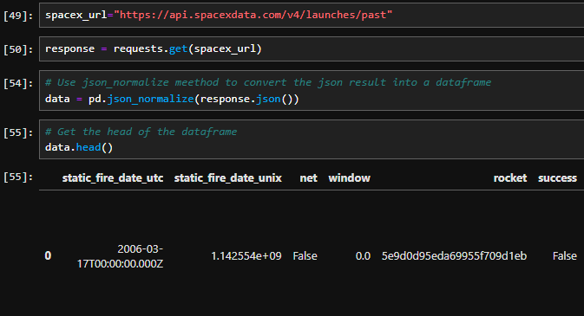
Data Collection – SpaceX API
We utilized the GET request with the SpaceX API to gather the data.
https://github.com/AfterRain007/TFDS/blob/main/Finale/1%20jupyter-labs-spacex-data-collection-api.ipynb

Slide 9
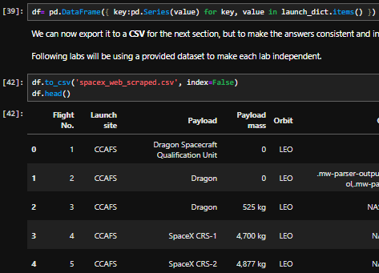
Data Collection - Scraping
We employed web scraping techniques to extract Falcon 9 launch records from a webpage using BeautifulSoup. After parsing the table, we are able to transformed the data into a pandas dataframe.
https://github.com/AfterRain007/TFDS/blob/main/Finale/1%20jupyter-labs-webscraping.ipynb

Slide 10
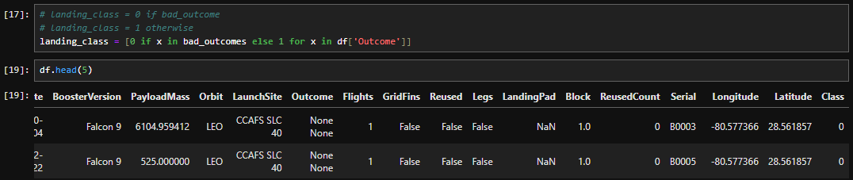
Data Wrangling
Before going into Exploratory Data Anlysis, etc etc. First thing first we need to do some Data Wrangling! Let’s Create a landing outcome label from Outcome column, where we set 0 to the bad outcome and 1 if it’s otherwise. We can achieve this by doing simple list comprehension.

Slide 11
EDA with Data Visualization
Now, let’s explore the data to better understand it’s value. There’s a couple chart that we plotted, which are
Scatter Plot
Line Plot
Bar Plot
We use these chart to better understand the correlation between two variable!
https://github.com/AfterRain007/TFDS/blob/main/Finale/4%20jupyter-labs-eda-dataviz.ipynb

Slide 12
EDA with SQL
Not only with pandas, we can use SQL too in Jupyter Notebook! In this example we load the SpaceX dataset into a PostgreSQL database and gain some insight from the dataset!
https://github.com/AfterRain007/TFDS/blob/main/Finale/5%20jupyter-labs-eda-sql-coursera_sqllite.ipynb

Slide 13
Build an Interactive Map with Folium
How does one build a map? Let alone in python? Well, let me introduce you to Folium!
With Folium, we are capable of marking all the launch sites with markers, circles, and line! Where if there’s a high success rate based on the data in one launch site, we are able to make the colors to the said markers to be green.
https://github.com/AfterRain007/TFDS/blob/main/Finale/6%20lab_jupyter_launch_site_location.ipynb

Slide 14
Build a Dashboard with Plotly Dash
We can also build an interactive dashboard in Jupyter Notebook using Plotly Dash. With this dashboard, you don’t need to change any line of code! So everyone can see the insight of the data intuitively.
https://github.com/AfterRain007/TFDS/blob/main/Finale/spacex_dash_app.ipynb

Slide 15
Predictive Analysis (Classification)
Now let’s do some Predictive Analysis!
Load the data into a pandas dataframe to do some data wrangling
Split the data into 2, which are training and testing data
Train a couple of model using our training data with GridSearchCV as our hyperparameter tuning
Evaluate each model to compare which one is the best
https://github.com/AfterRain007/TFDS/blob/main/Finale/8%20SpaceX_Machine_Learning_Prediction_Part_5.jupyterlite.ipynb

Slide 16
Results
Exploratory data analysis results
There are 4 launch site used by spaceX which are CCAFS LC-40, VAFB SLC-4E, KSC LC-39A, and CCAFS SLC-40
The total payload masss done by SpaceX are 107010 kg with an average of 2534 kg
The first success landing outcome happened in 2015
SpaceX have a 99% success rate.

Slide 17
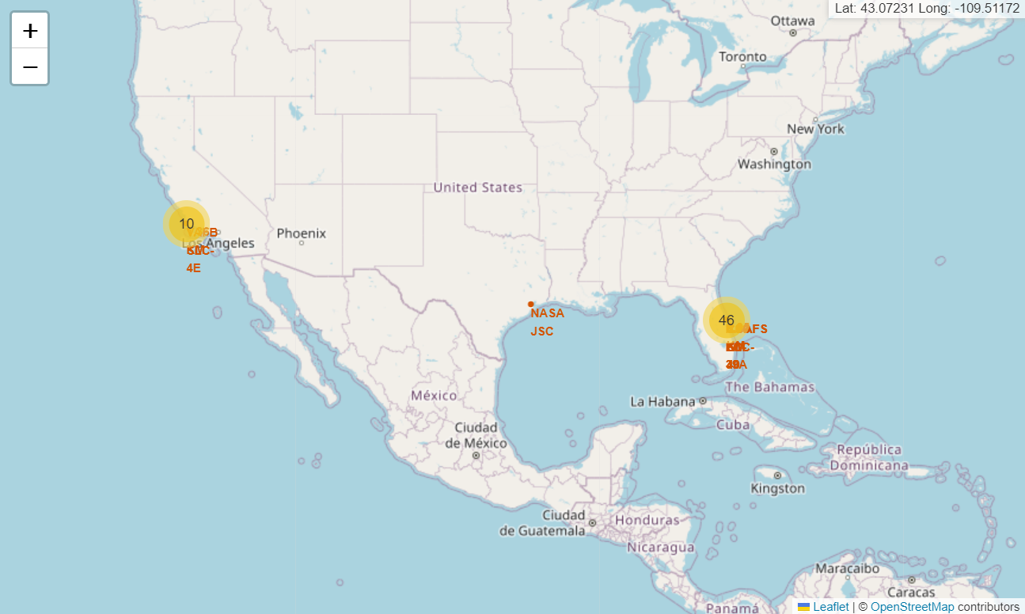
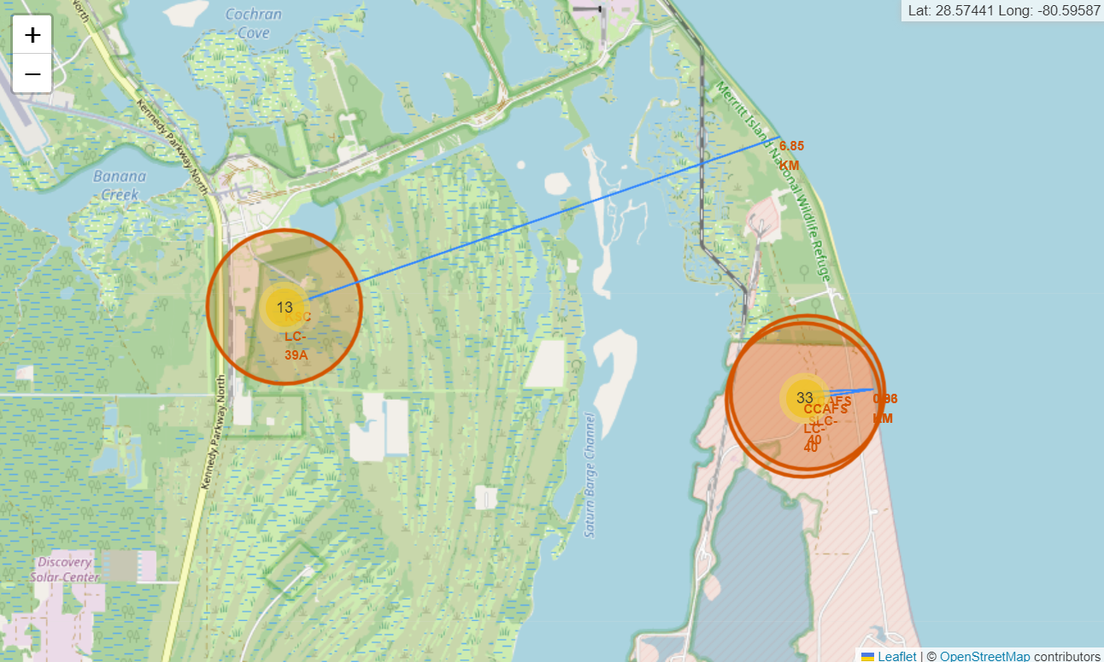
Results
Interactive analytics demo in screenshots

Slide 18
Results
Predictive analysis results
Comparing 4 model (logreg, SVM, Decision Tree, and KNN), it’s found that using model logreg is the best based on this dataset with an accuracy score of 94.44%.

Slide 19

Section 2

Slide 20
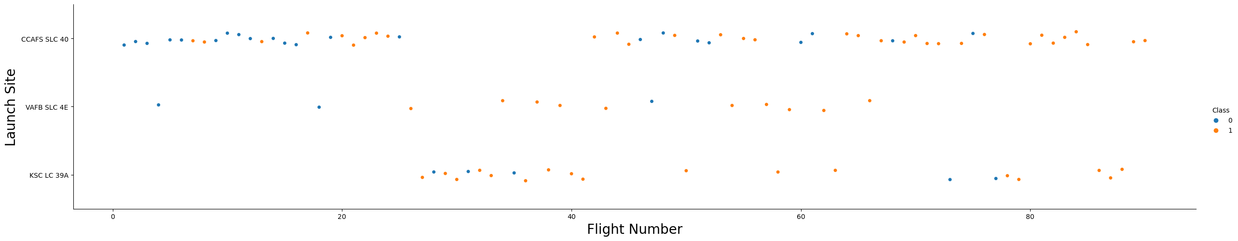
Flight Number vs. Launch Site
Based on the plot above, it is found that as the number of flights increased at a launch site, the success rate also increase.

Slide 21
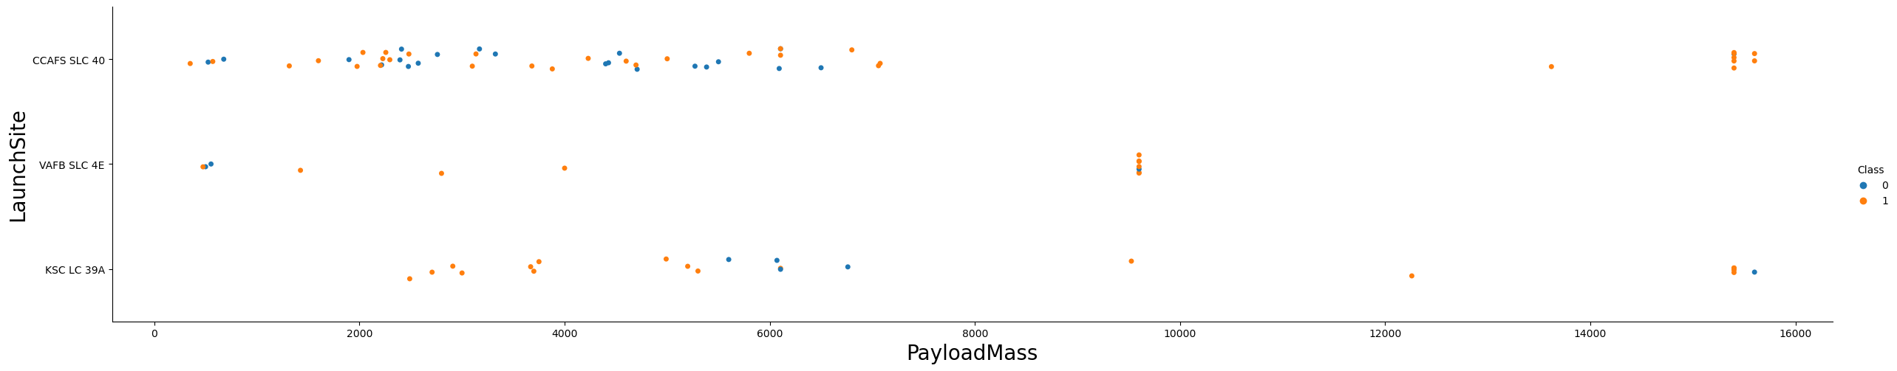
Payload vs. Launch Site
A correlation was observed indicating that a higher payload mass at launch site CCAFS SLC 40 corresponds to a higher success rate for the rocket.

Slide 22
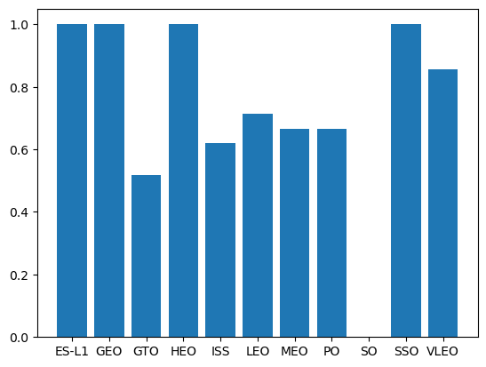
Success Rate vs. Orbit Type
The plot highlights that missions to ES-L1, GEO, HEO, and SSO orbits exhibited the highest success rates.

Slide 23
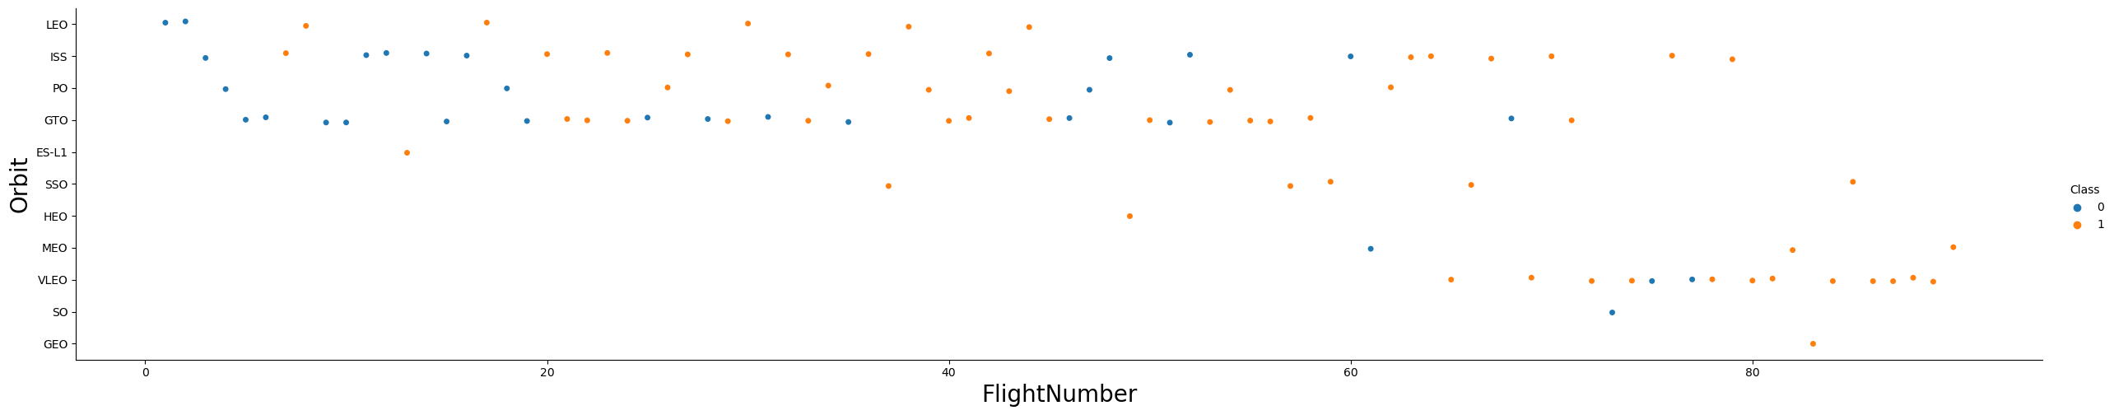
Flight Number vs. Orbit Type
In the LEO orbit, success appears to be correlated with the number of flights, whereas in the GTO orbit, there is no discernible relationship between the number of flights and the orbit's success rate.

Slide 24
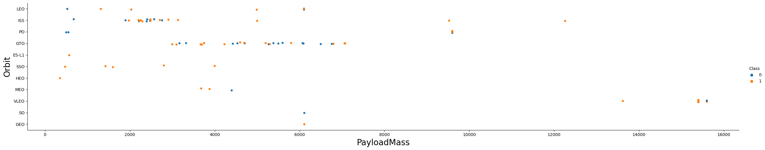
Payload vs. Orbit Type
It can be observed that with heavier payloads, successful landings are more common for PO, LEO, and ISS orbits.

Slide 25
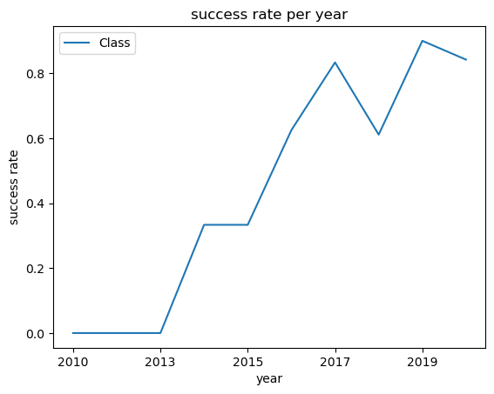
Launch Success Yearly Trend
According to the plot, the success rate has steadily increased from 2013 to 2020.

Slide 26
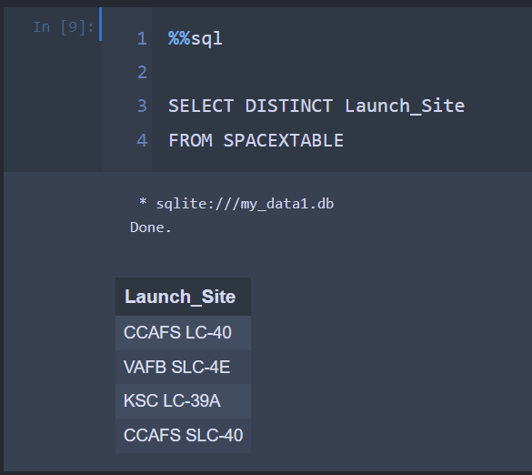
All Launch Site Names
There are 4 Launch Site,
CCAFS LC-40
VAFB SLC-4E
KSC LC-39A
CCAFS SLC-40

Slide 27
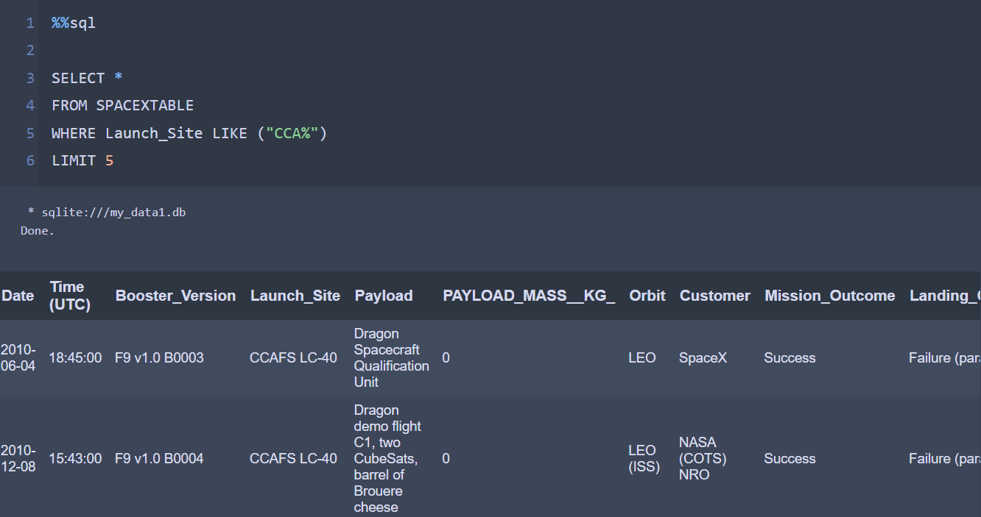
Launch Site Names Begin with 'CCA'
The query above is to showcase five records where the launch sites start with "CCA".

Slide 28
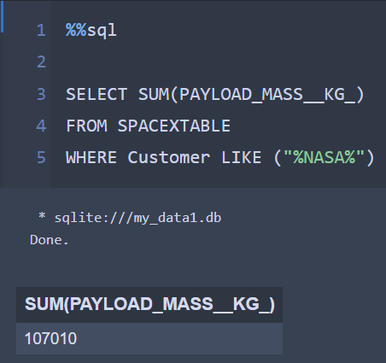
Total Payload Mass
It is found that the sum of mass in payload are 107.010 kg

Slide 29
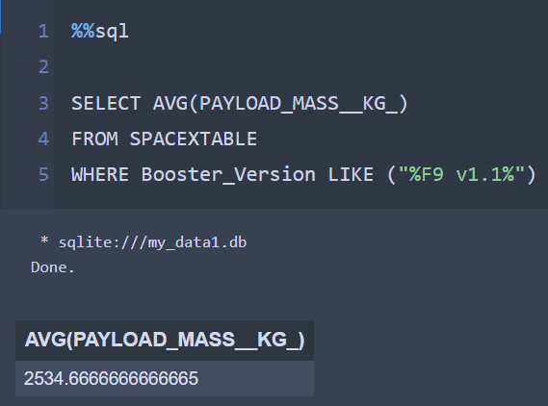
Average Payload Mass by F9 v1.1
With an average payload mass of 2534.66 KG

Slide 30
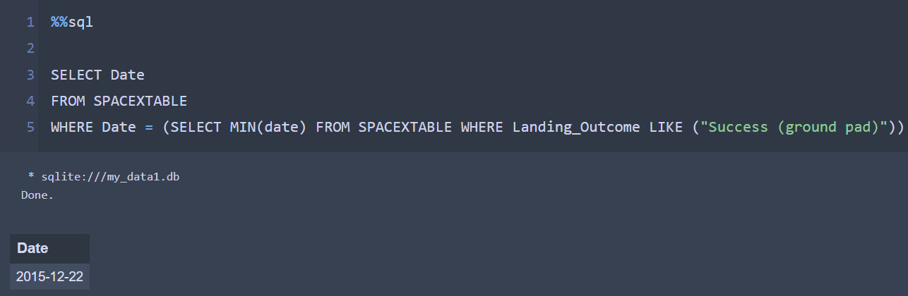
First Successful Ground Landing Date
With the first Successful ground landing on 22nd of December 2015

Slide 31
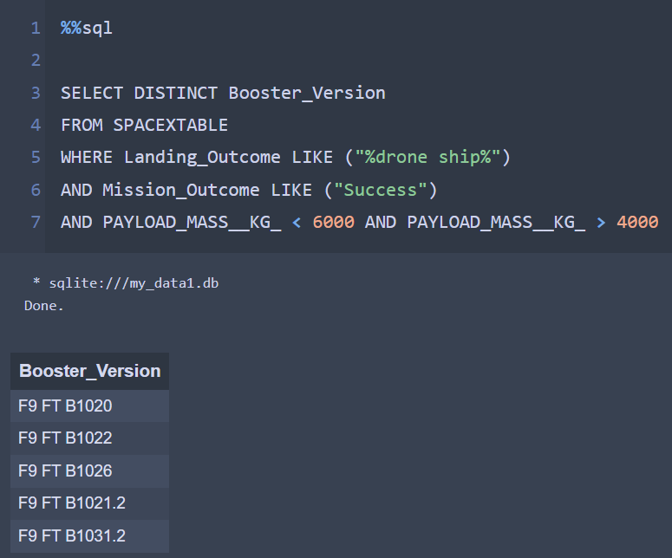
Successful Drone Ship Landing with Payload between 4000 and 6000
It is found that there are 5 Successful Drone Ship Landing with Payload between 4000 and 6000. Which are:
F9 FT B1020
F9 FT B1022
F9 FT B1026
F9 FT B1021.2
F9 FT B1031.2

Slide 32
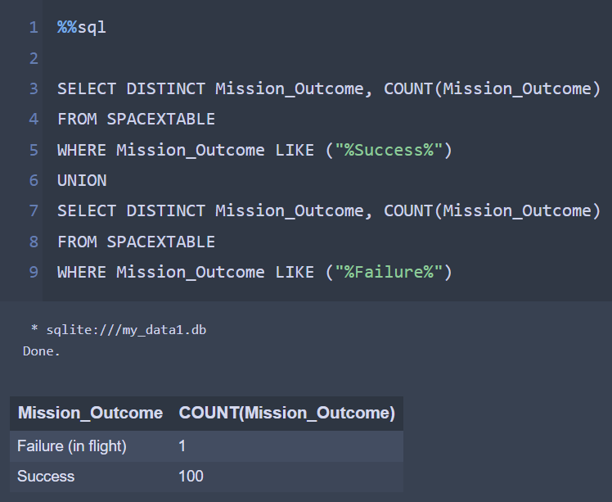
Total Number of Successful and Failure Mission Outcomes
The total number of Successful Mission Outcome Exceed the Failed one with the ratio of 100:1

Slide 33
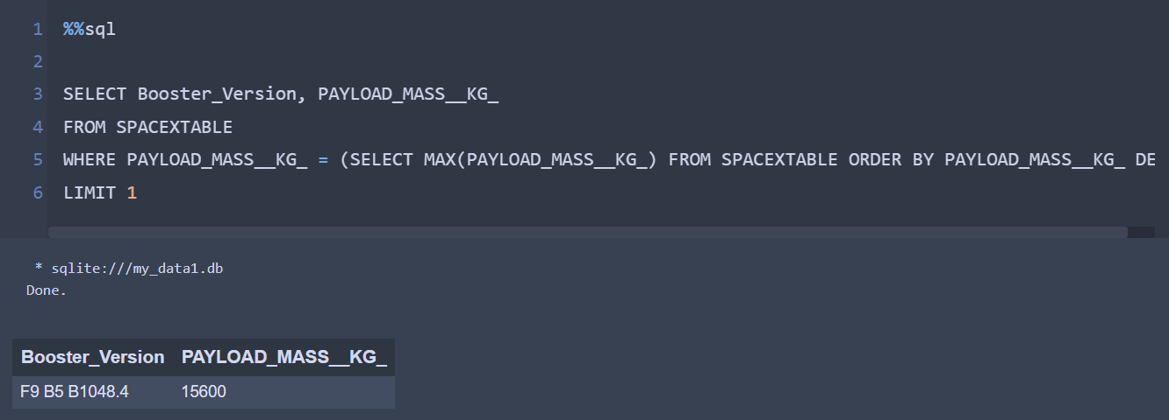
Boosters Carried Maximum Payload
Booster with the heaviest payload fell to F9 B5 B1048.4 with payload of 15600

Slide 34
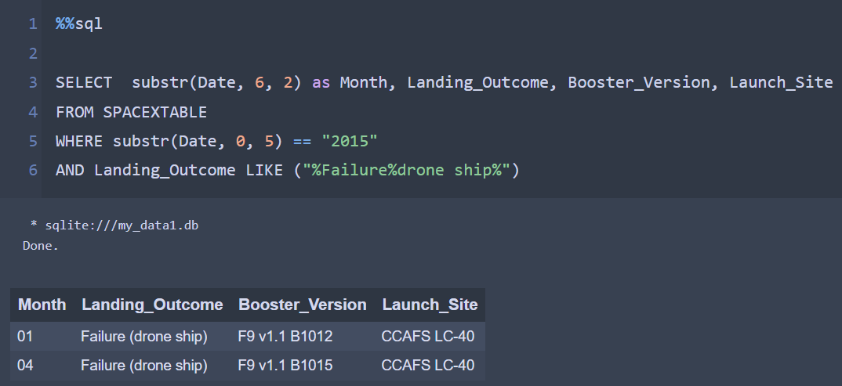
2015 Launch Records
There are 2 failure in the year of 2015. And it was carried by F9 v1.1 B1012 and F9 v1.1 B10915 Booster, with both booster launched in the Launch Site of CCAFS LC-40

Slide 35
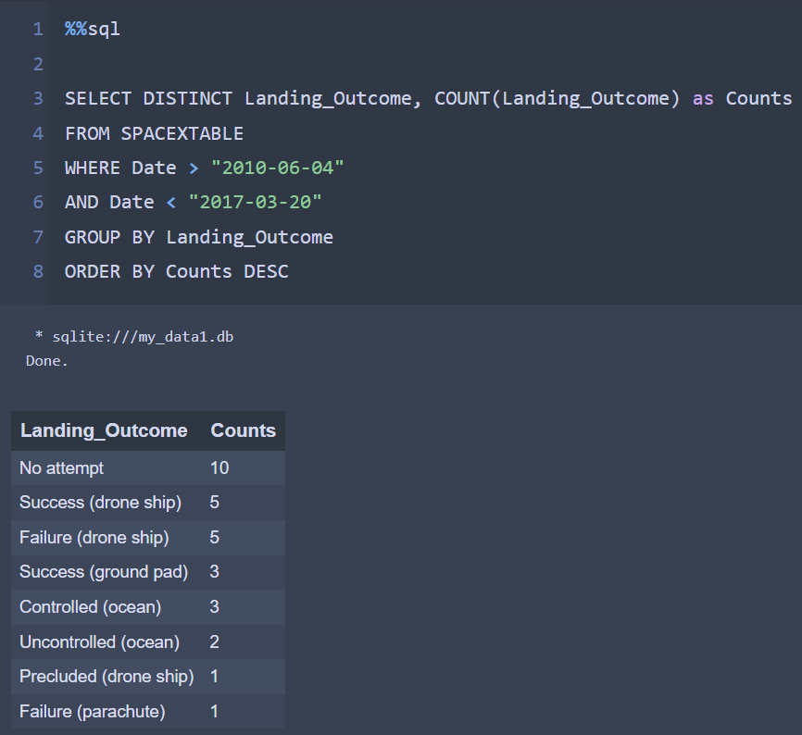
Rank Landing Outcomes Between 2010-06-04 and 2017-03-20
Between 2010-06-04 and 2017-03-20 it is found there are 10 counts of no attempt, followed with success on drone ship tied with failure on drone ship.

Slide 36

Section 3

Slide 37
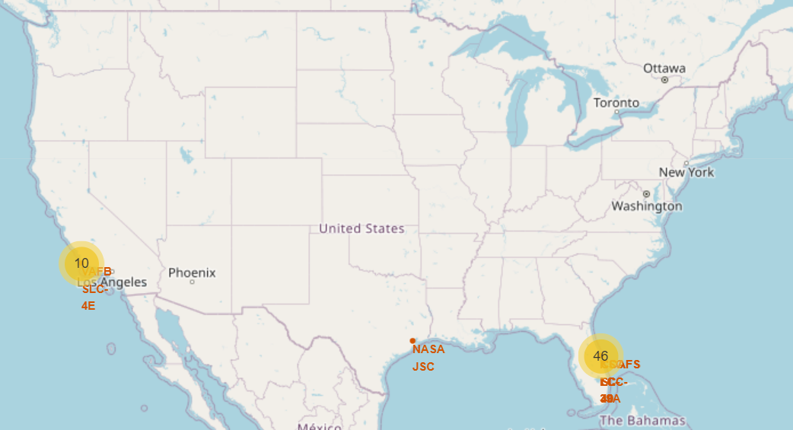
<Launch Site>
Using Folium we are able to put marker and circle to the launch site, with addition of sum of launch has been done on each launch site

Slide 38
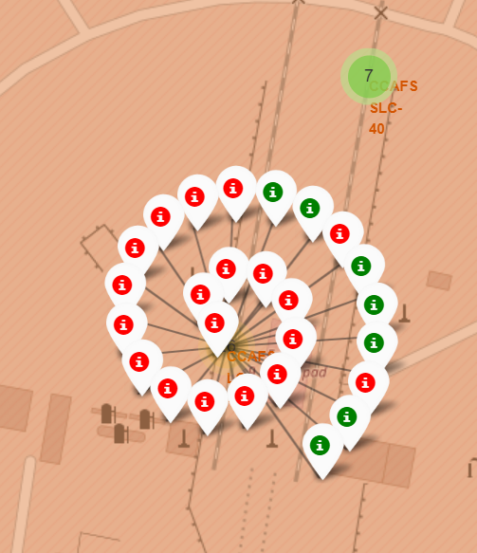
<Successful and Failure Marker>
We can also see how many lunch has been a success or failure on each launch site

Slide 39
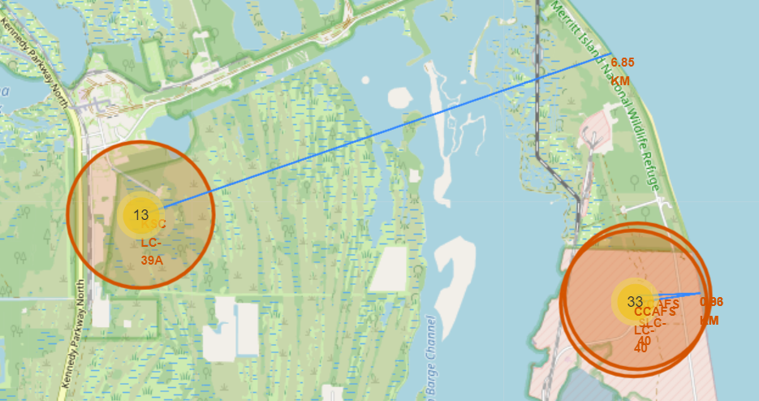
<Distance>
Using folium, we could also put a line to see how far is the distance from one coordinate to another, here an example of launch site to the nearest coastline

Slide 40

Section 4

Slide 41
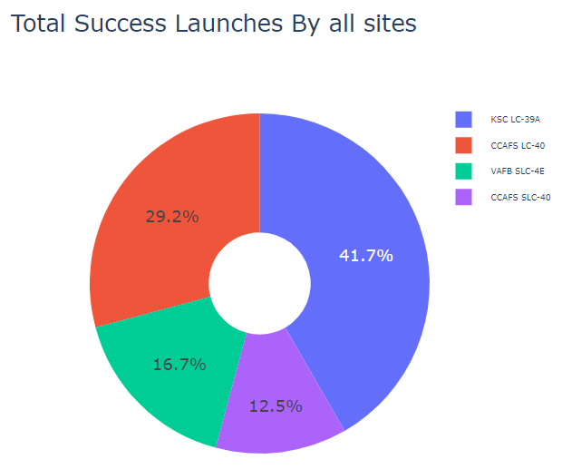
<Pie Chart Success Percentage by Each Launch Site>
From the pie chart we can conclude that KSC LC-39A have the highest percentage of Success

Slide 42
<Piechart for the Launch Site with Highest Launch Success Ratio>
From the pie chart we can conclude that KSC LC-39A have success rate of 76.9%

Slide 43
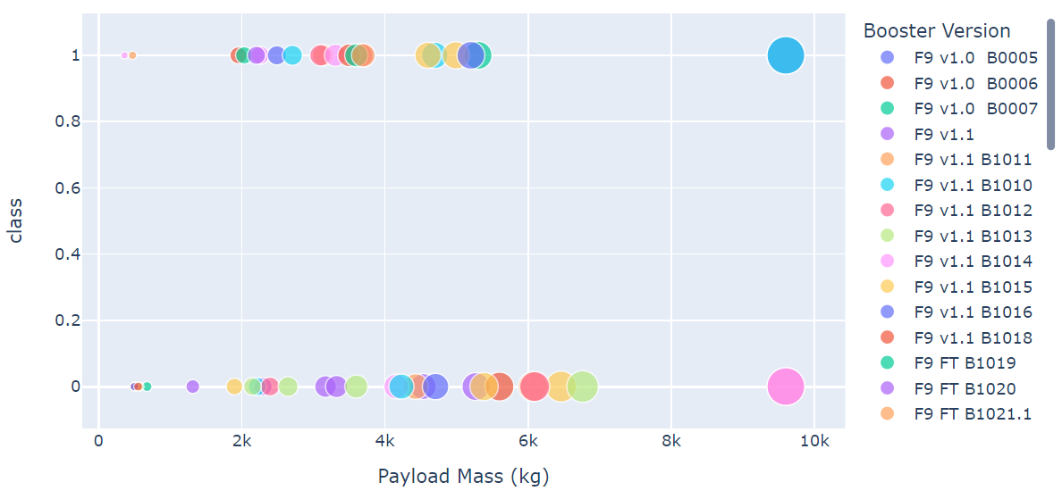
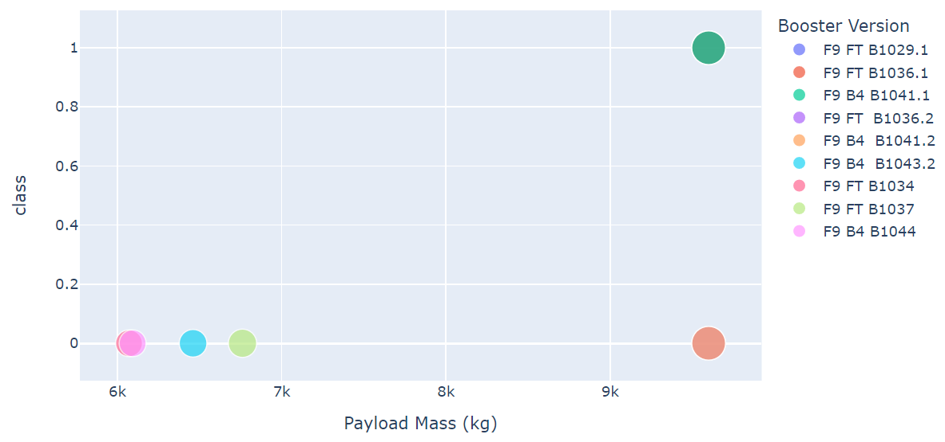
<Payload Vs. Launch Outcome Scatter Plot>
From the scatter plot we can can conclude that the more heavy the payload, the lower chances of success

Slide 44

Section 5

Slide 45
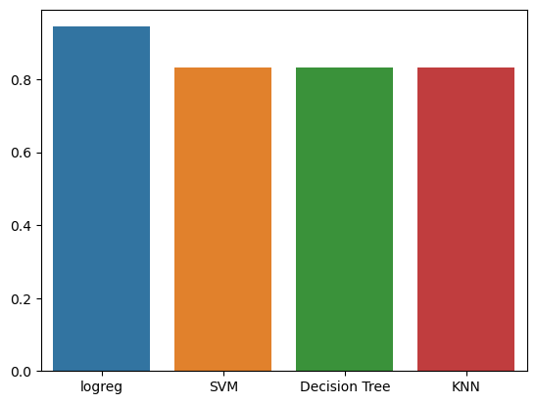
Classification Accuracy
As we can see, Classification Accuracy for the model logreg score higher than any other model. So we can conclude logreg is the best model

Slide 46
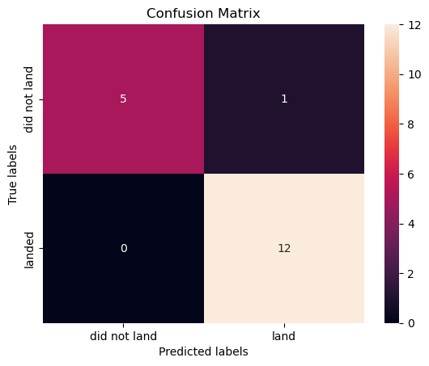
Confusion Matrix
With the LogReg model Confusion matrix almost scoring a perfect score. With only one False Positive, while the other data point scoring according the test data.

Slide 47
Conclusions
In summary, the following conclusions can be drawn:
There is a positive correlation between the number of flights at a launch site and the success rate.
The launch success rate has shown a continuous increase from 2013 to 2020. With a slight hiccup in 2018.
Orbits ES-L1, GEO, HEO, SSO, and VLEO demonstrated the highest success rates.
KSC LC-39A stands out as the launch site with the highest number of successful launches.
Among the machine learning algorithms evaluated, the LogReg model performed the best for this task.

Slide 48


